Slide 1


Version control with git and GitHub
Kim Dill-McFarland, PhD
Feb 11, 2021
kadm@uw.edu @kdillmcfarland Slides https://tinyurl.com/4zsqs2rd

Slide 2
Why version control?
Collaborate with yourself
Collaborate with others
Share with the world!
kadm@uw.edu @kdillmcfarland Slides https://tinyurl.com/4zsqs2rd

Slide 3
Version control
Date files
Version numbers (v1.0.0)
Distributed (git)
kadm@uw.edu @kdillmcfarland Slides https://tinyurl.com/4zsqs2rd

Slide 4

kadm@uw.edu @kdillmcfarland Slides https://tinyurl.com/4zsqs2rd

Slide 5
Distributed version control
Current version and complete history are distributed together
Time-stamp
Comment
Author
kadm@uw.edu @kdillmcfarland Slides https://tinyurl.com/4zsqs2rd

Slide 6
Collaborate with yourself
git on your local computer

Slide 7
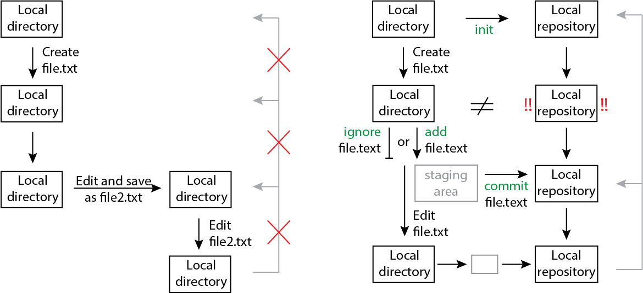
“Standard” workflow
kadm@uw.edu @kdillmcfarland Slides https://tinyurl.com/4zsqs2rd

Slide 8
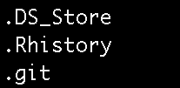
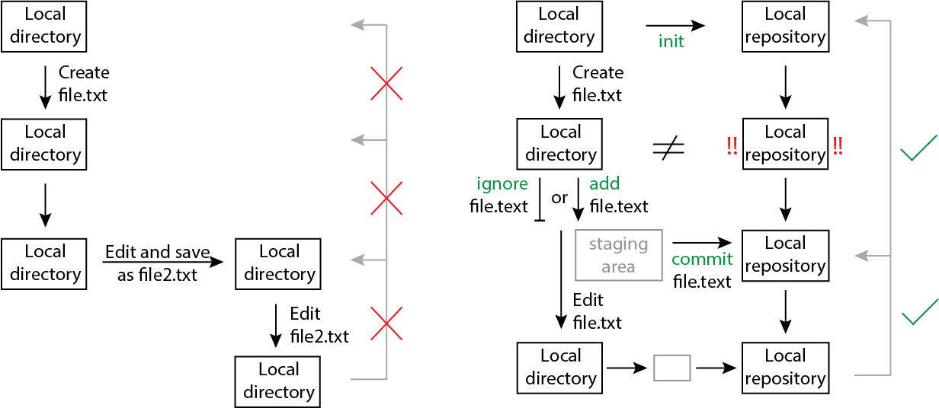
git workflow
kadm@uw.edu @kdillmcfarland Slides https://tinyurl.com/4zsqs2rd

Slide 9
The staging area (index)
When would you add to the staging area but not commit to the repository?
Adding multiple files, saving under 1 commit
Not sure you want that particular version saved
kadm@uw.edu @kdillmcfarland Slides https://tinyurl.com/4zsqs2rd

Slide 10
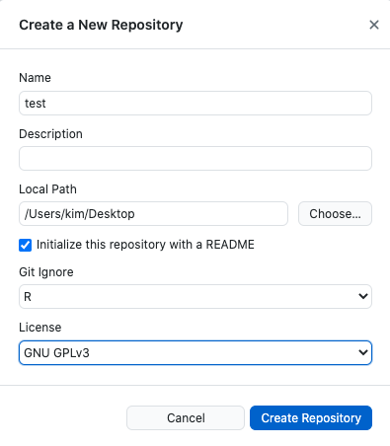
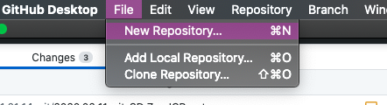
Create a new repository
Always have a README
Optionally auto generate common ignored files for different programs
Add license so others can use your code if made public
kadm@uw.edu @kdillmcfarland Slides https://tinyurl.com/4zsqs2rd

Slide 11
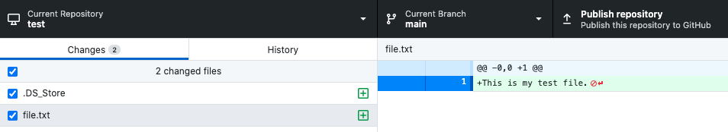
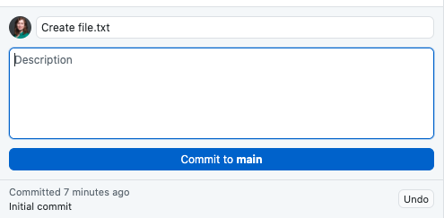
Add and commit a file
If it is a text-based file, see line specific changes since last commit
Select file(s) to add
Must have a main commit message
Optional additional details
Most recent commit message
kadm@uw.edu @kdillmcfarland Slides https://tinyurl.com/4zsqs2rd

Slide 12
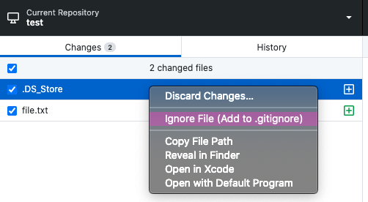
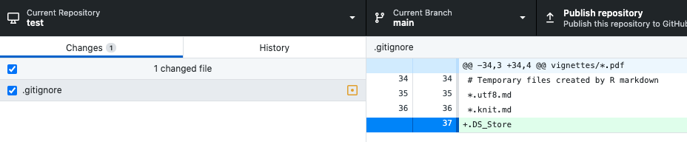
Ignore a file
Right-click
kadm@uw.edu @kdillmcfarland Slides https://tinyurl.com/4zsqs2rd

Slide 13
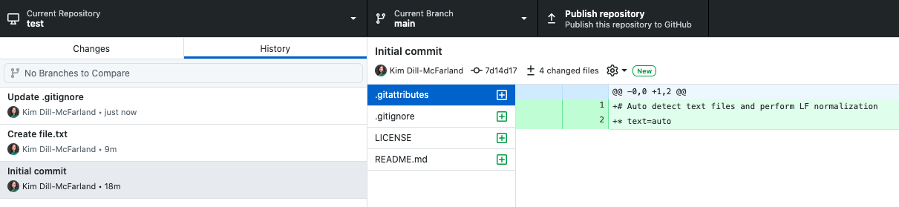
View complete history
kadm@uw.edu @kdillmcfarland Slides https://tinyurl.com/4zsqs2rd

Slide 14
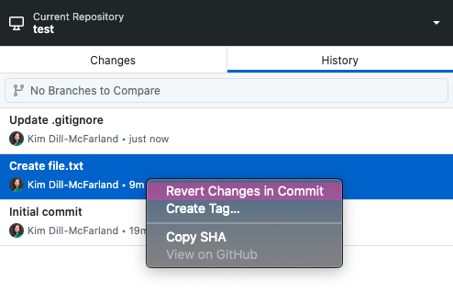
Revert back to old versions
Right-click
kadm@uw.edu @kdillmcfarland Slides https://tinyurl.com/4zsqs2rd

Slide 15
Collaborate with others
GitHub and your organization

Slide 16
GitHub
Remote backup
Share files within your organization or publicly
Contribute to public coding projects
Additional collaboration features
kadm@uw.edu @kdillmcfarland Slides https://tinyurl.com/4zsqs2rd

Slide 17
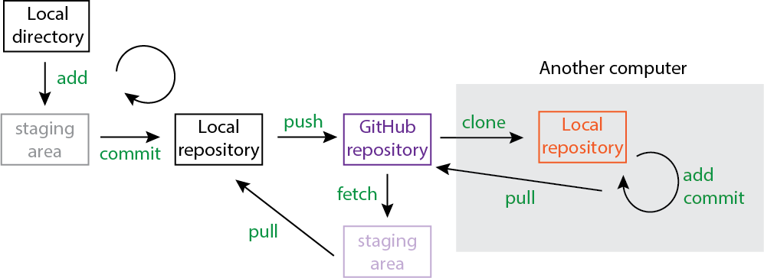

GitHub workflow
kadm@uw.edu @kdillmcfarland Slides https://tinyurl.com/4zsqs2rd

Slide 18
git and GitHub limitations
Best for text-based files (Rscript, Rmarkdown)
GitHub max file size 100MB
LFS allows larger but not free https://git-lfs.github.com/
Private repos not free
EXCEPT for education and research
https://docs.github.com/en/free-pro-team@latest/education/teach-and-learn-with-github-education/apply-for-an-educator-or-researcher-discount
kadm@uw.edu @kdillmcfarland Slides https://tinyurl.com/4zsqs2rd

Slide 19
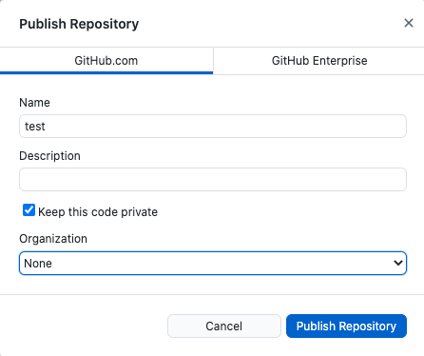
Publish to GitHub
Public vs private. Not all accounts have this option
If you’re part of an organization
kadm@uw.edu @kdillmcfarland Slides https://tinyurl.com/4zsqs2rd

Slide 20
Working with GitHub
Check if local and GitHub match
Local copy does not match GitHub.
Click to update GitHub
Local copy does not match GitHub.
Click to update local
kadm@uw.edu @kdillmcfarland Slides https://tinyurl.com/4zsqs2rd

Slide 21
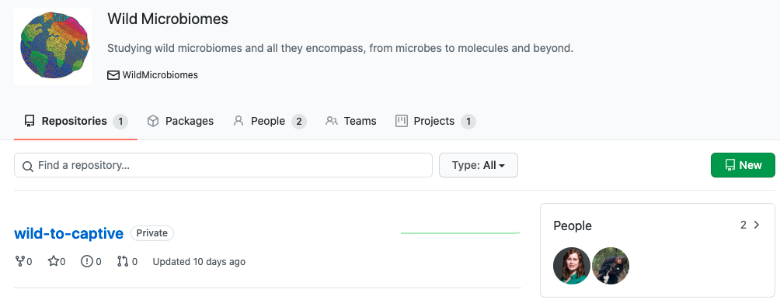
GitHub organizations
Shared repository space
Shared features (e.g. private repos, LFS, etc)
https://github.com/Wild-Microbiomes
kadm@uw.edu @kdillmcfarland Slides https://tinyurl.com/4zsqs2rd

Slide 22
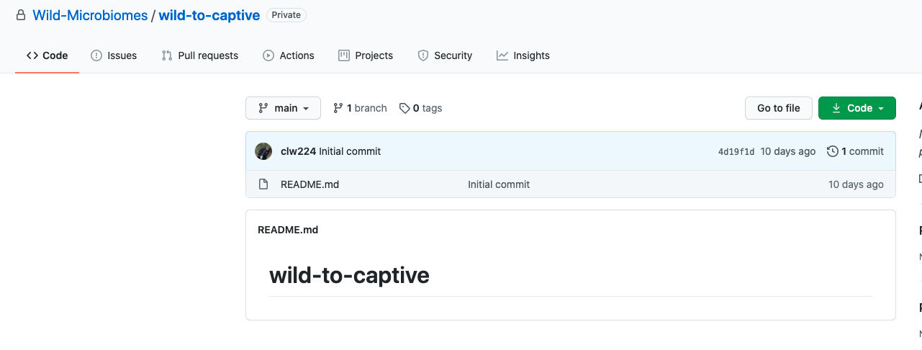
GitHub repos
Let others know about errors, requested features, etc in their repo
Requests to merge in someone else’s code
Files in repo
Automatically renders README
kadm@uw.edu @kdillmcfarland Slides https://tinyurl.com/4zsqs2rd

Slide 23
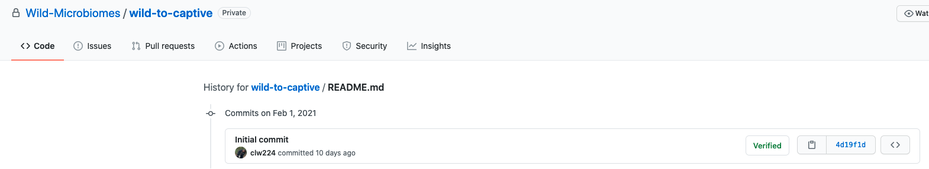
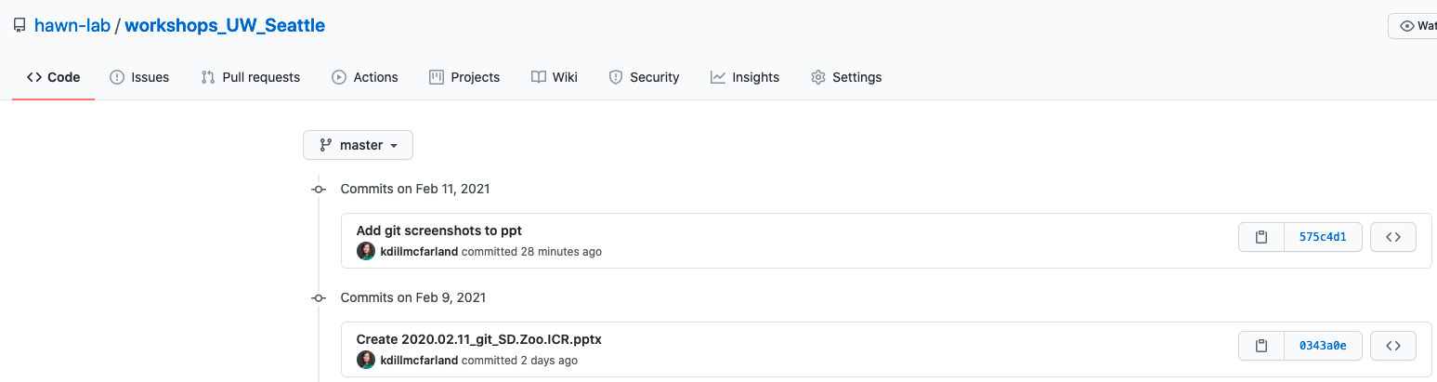
GitHub history
Select a file and view its commit history
Or view an entire repo’s history
kadm@uw.edu @kdillmcfarland Slides https://tinyurl.com/4zsqs2rd

Slide 24
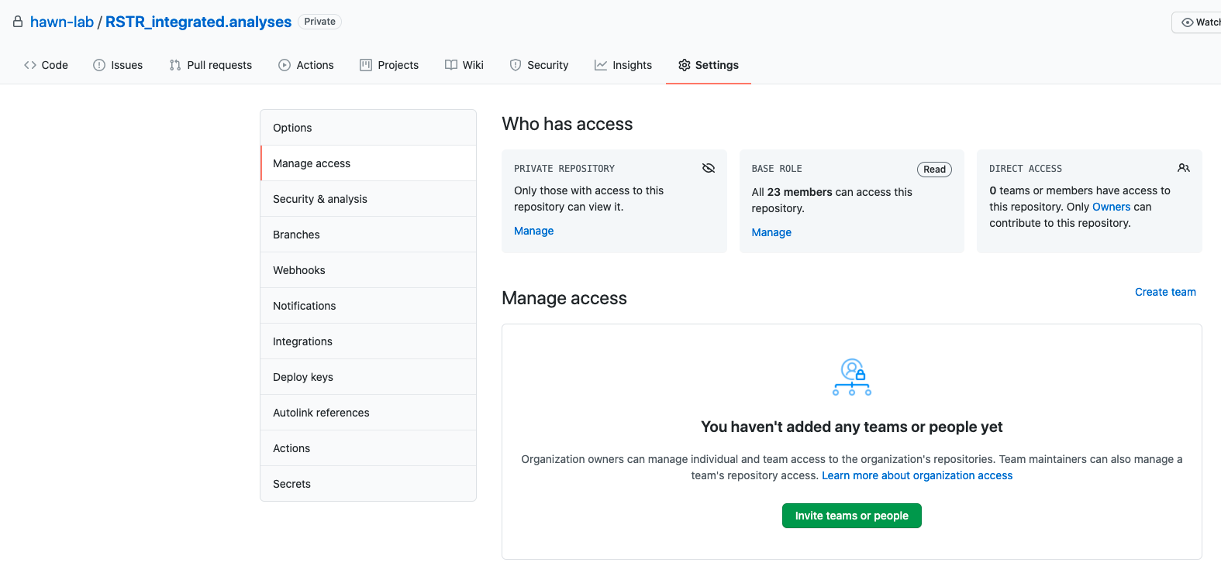
GitHub permissions
kadm@uw.edu @kdillmcfarland Slides https://tinyurl.com/4zsqs2rd

Slide 25
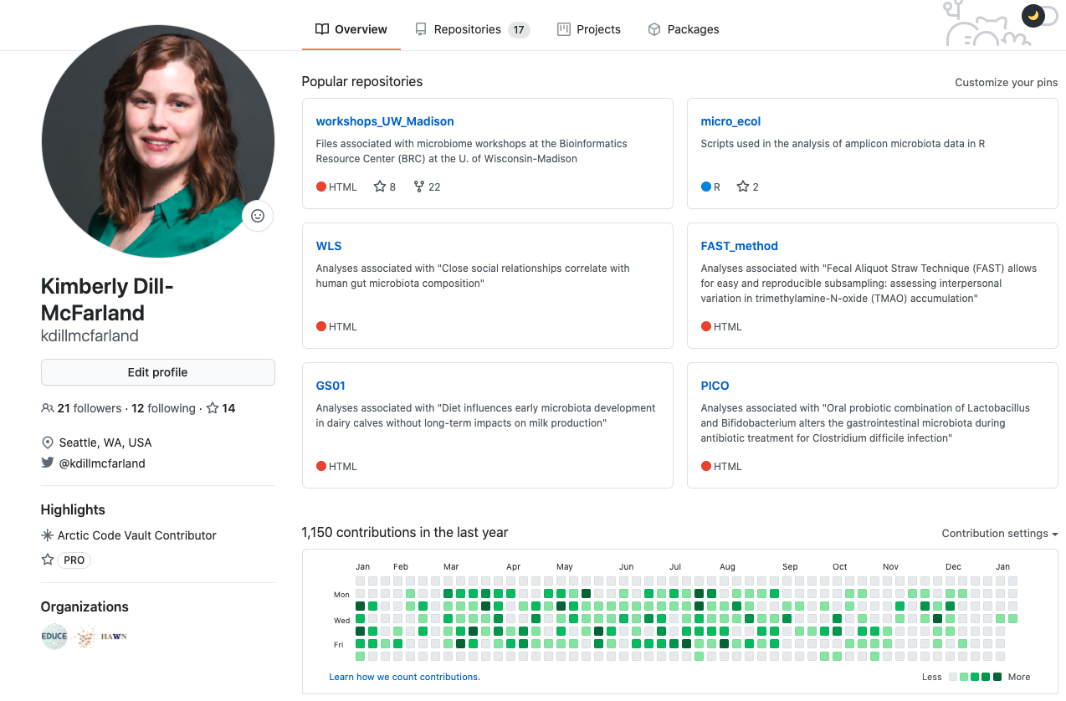
Share with the world!
kadm@uw.edu @kdillmcfarland Slides https://tinyurl.com/4zsqs2rd

Slide 26

One major aspect we did not have time for
git branches
Have multiple, simultaneous copies of files at different version points
Useful if you want to try something without changing your currently working version or if multiple people simultaneously work on a file
Main
Image nobeldesktop.com

Slide 27
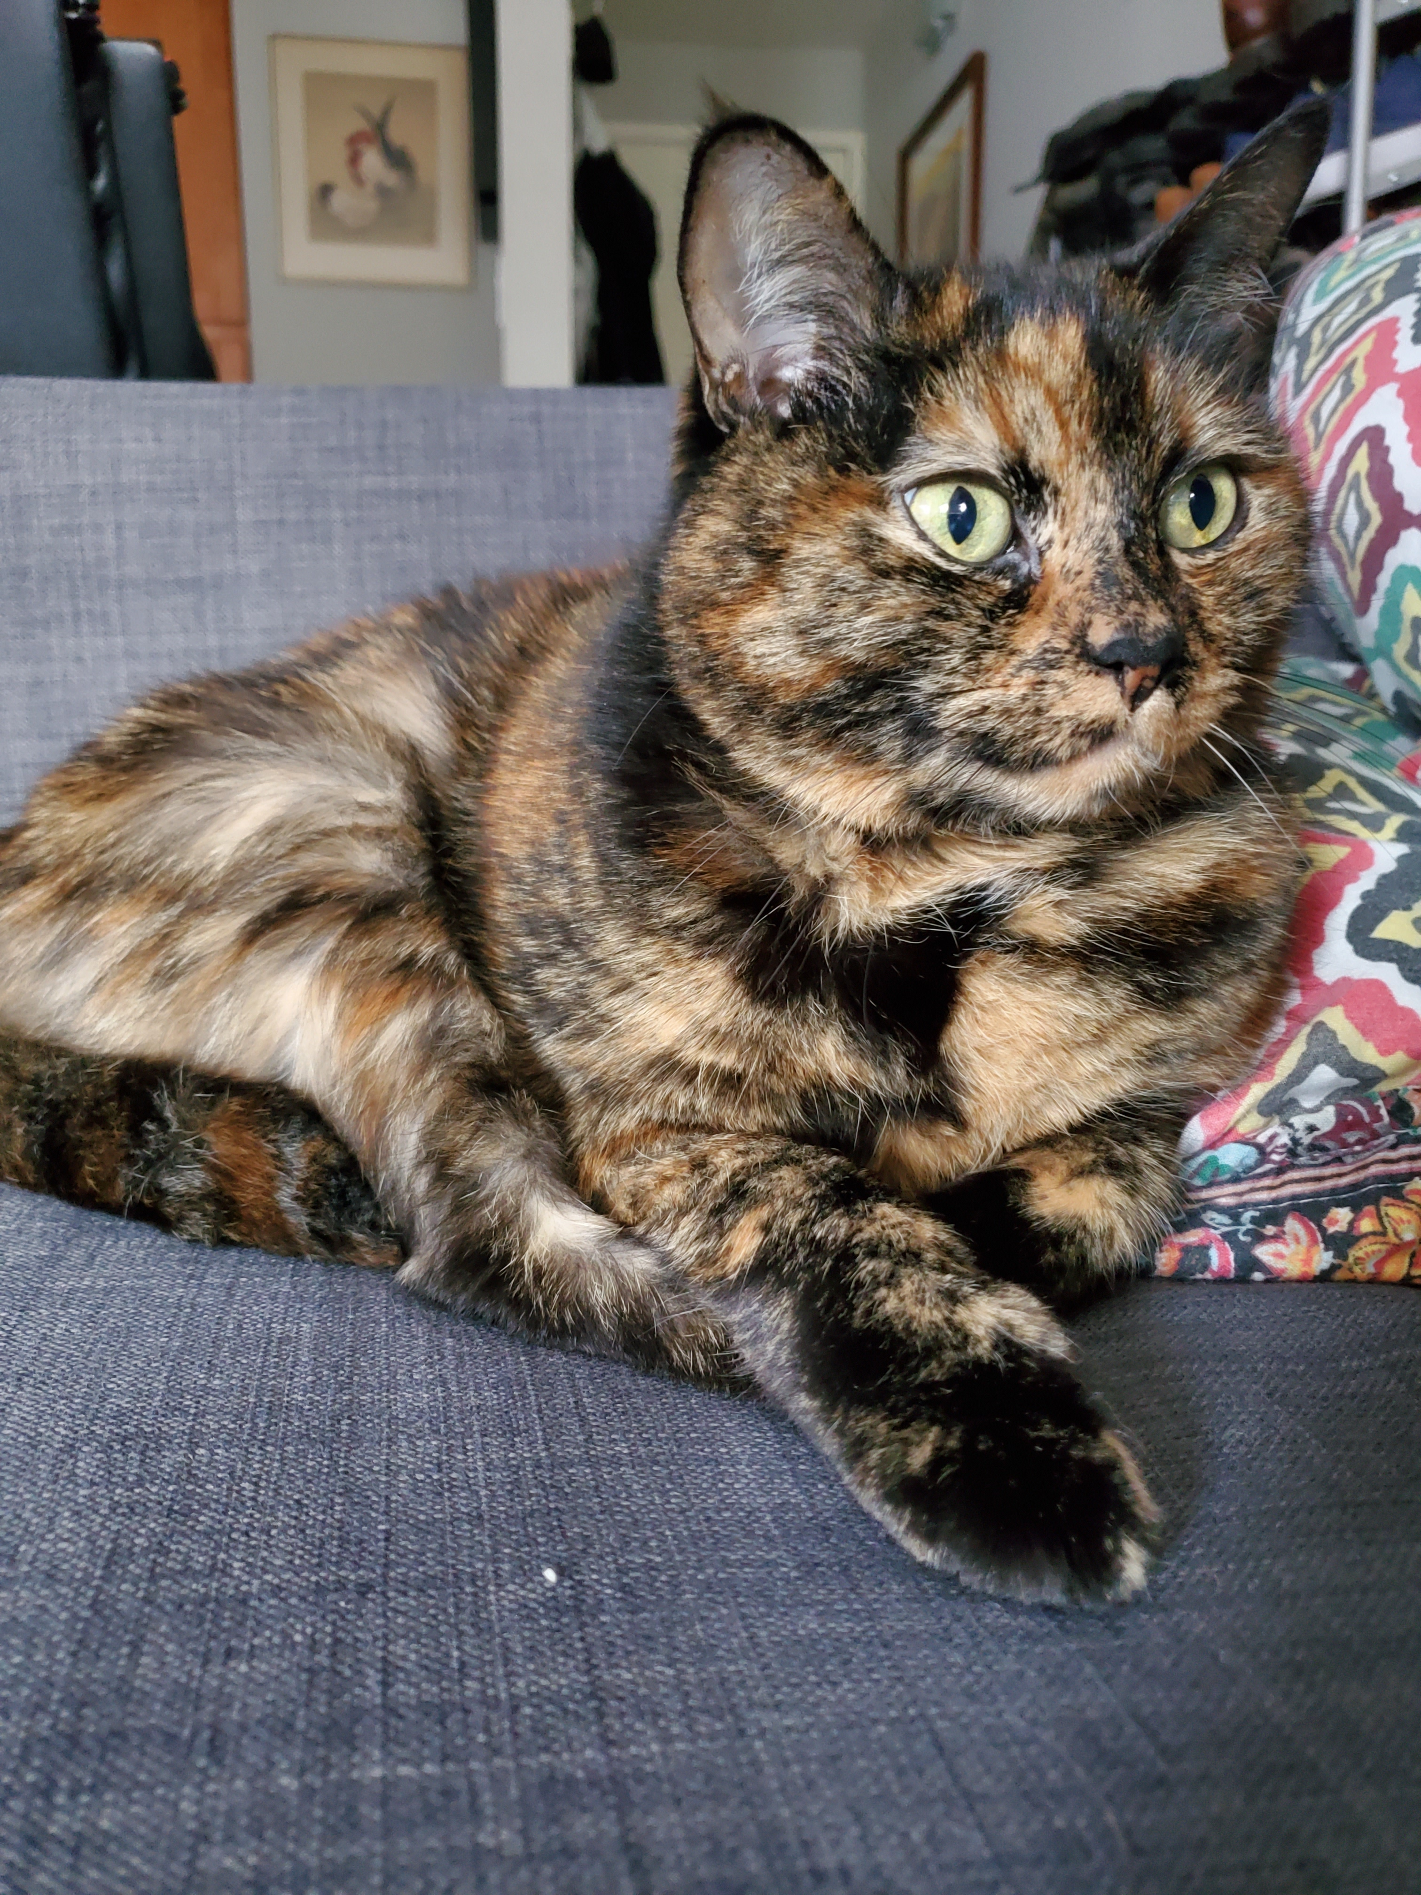
Questions?
kadm@uw.edu @kdillmcfarland Slides https://tinyurl.com/4zsqs2rd

